Slide 1
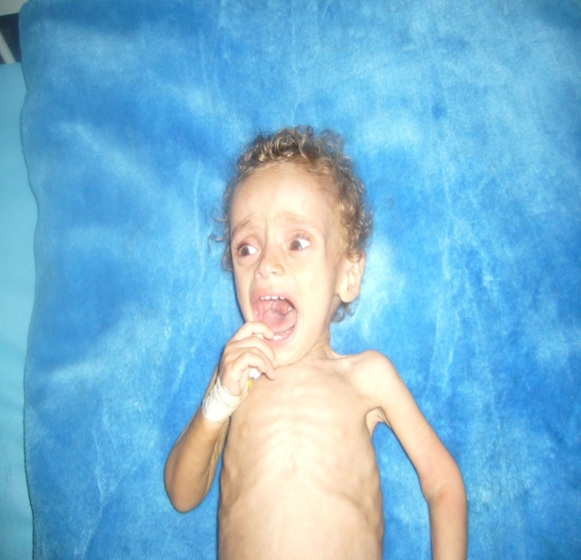
Failure to thrive (FTT)
(Weight faltering )
Reference
Nelson text book
Illustrated text book of pediatric

Slide 2
Objectives 1) Relevant points in history , physical examination and growth chart 2)Essential aspects in managements

Slide 3
Case study A 12 –month- old female who presents for a well child check. Within the past 4 months, her weight has fallen from the 25th percentile to significantly less than the 5th percentile.

Slide 4
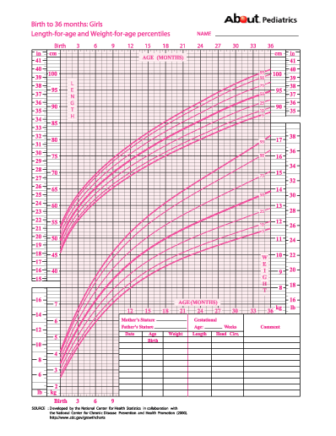

Slide 5
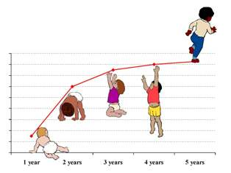
Definition Height and weight at or below the 3rd to 5th percentile for age (less than 2 SD) or Dropping two growth percentiles

Slide 6
History

Slide 7
What are the important aspects in the history of this child ?

Slide 8
Feeding history

Slide 9
She seems to eat appropriate foods for her age, but her mother notes that she tends to be restless while eating, and that she does not like the texture of certain foods.

Slide 10
Comprehensive review of systems

Slide 11
Urine is normal. There are no symptoms of respiratory or neurological disease, and her review of systems is otherwise negative.

Slide 12
Her language, motor, cognitive, and social development are normal.

Slide 13
History
Feeding history
Comprehensive review of systems
Developmental and psychosocial
Family History growth, development, and medical illnesses

Slide 14
Physical examination

Slide 15
Dysmorphic
features
Underlying
disease
Malnutrition
Child abuse

Slide 16
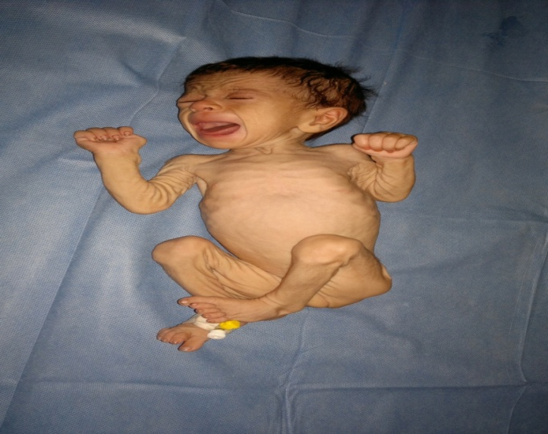
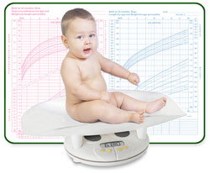
How you asses severity of FTT?

Slide 17
Gomez criteria Current WFA ÷ Expected wt×100
*less 60 % of expected
( severe)
*61 - 75 % ( moderate)
*76 - 90 % (mild)

Slide 18
Types -Organic (less than 5%) *GE reflux * coeliac disease * cystic fibrosis * cardiac disease * renal failure ---Non organic (psychosocial and environmental deprivation ) ---Mixed

Slide 19
Differential Diagnosis Inadequate caloric intake Inadequate absorption Increased metabolism Defective utilization

Slide 20
Case study A 12 –month- old female who presents for a well child check. Within the past 4 months, her weight has fallen from the 25th percentile to significantly less than the 5th percentile. Management ??

Slide 21
Parent-child interaction
Laboratory evaluation
Nutrition intervention

Slide 22
*Three-day food diary *High-calorie diet *150 % expected weight *added cheese ,butter *Limit fruit juice.

Slide 23
Hospitalization *safety is a concern *failed outpatient * severe FTT

Slide 24
Outcomes Difficult to comment on the long-term Risk for *short stature *behavior problems *developmental delay

